Slide 1



Functional or
Non-Functional
Task 3
Requirement Analysis
Group 8

Slide 2


Introduction
A
Requirement Analysis entails a systematic and meticulous examination aimed at comprehensively understanding the requisite functionalities necessary to effectively address a given problem or necessity.

Slide 3
Outline
B
1
Problem Statement
5
Filtered Non-Functional Requirements
2
6
Selection Criteria
Conceptual Design
3
Filtered Functional
Requirements
7
Technical Requirements
4
External Data Objects
8
Conclusion

Slide 4

Problem Statement
1
Drivers, Passengers, Pedestrians struggle to have upfront information about road state and road signs in order to adjust their itinery of their driving style because there are some road signs that are not physically present or hidden, and there is no reliable data source to have upfront road state information.

Slide 5
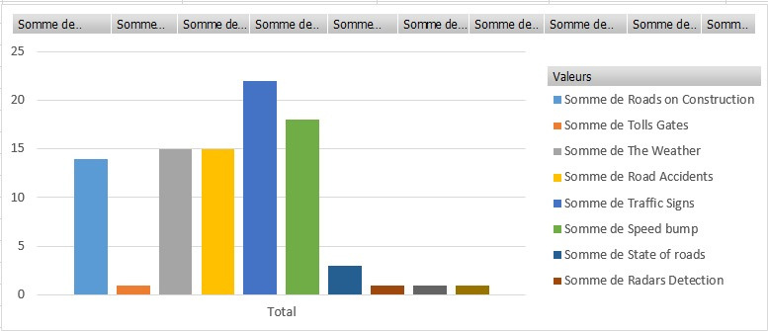
Selection Criteria
2
User Preference
i
Most Prefered stakeholder requirements were gotten from the analysis of stakeholder response on a histogram.

Slide 6
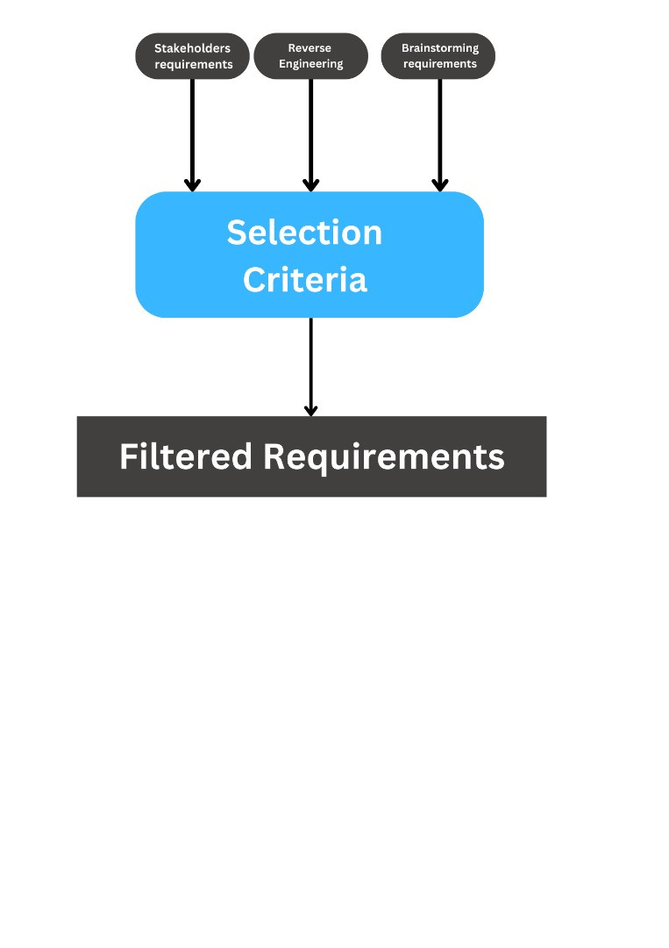
Selection Criteria
2
ii
SMART Criteria
Requirements were choosen beacause of
Specificity
Measureability
Attainability
Realism
Time Bound

Slide 7
Filtered Functional Requirements
3
i
Road Sign Notification
v
Route Redirection
ix
Real Time Speed Counter
ii
Weather Related Hazards
vi
Voice Assistance
x
Location Sharing
iii
Real-Time Traffic Update
vii
Location Tracking
xi
Define Frequently Accessed Locations
iv
Notification Preference
viii
Multilanguage Support
xii
Road State Update Permission

Slide 8
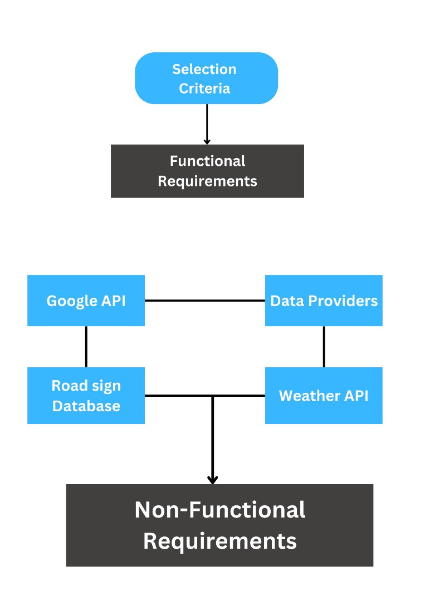
External Data Objects
4
i
ii
Google Maps API
Weather API
Road Sign Description Database
iii
Data Providers
iv

Slide 9






Scenario 1
d=7.63m
The Driver needs to:
See the Road Sign
React to the Road Sign

Slide 10
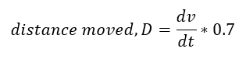
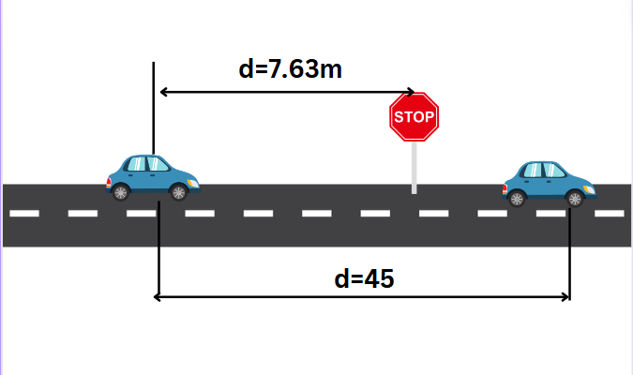
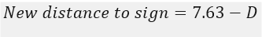


Scenario 1
MIT research shows that drivers take 0.75 seconds to detect obstacles while driving.
d=7.63m
D
MIT research shows that drivers take 0.75 seconds to detect obstacles while driving.
If the car is travelling at 60m/s The move distance moved wil be 45m which is past the Road Sign

Slide 11
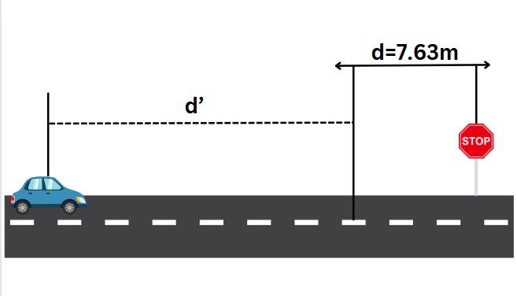
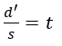
Scenario 1
Our App is capable of monitoring the cars speed
and knows the distance to the next Road Sign
So the app already know the time it will take the threshold distance (d) upon arriving at d’ we already start notifying the driver to the potential road sign
Performance
Reliability
Usuability
Why
Notes:
To avoid the pre

Slide 12






Scenario 2
User Stoke in Traffic Jamb
This can be due to an accident or car breakdown or other
How are we going to notify other coming to that location that there’s traffic

Slide 13
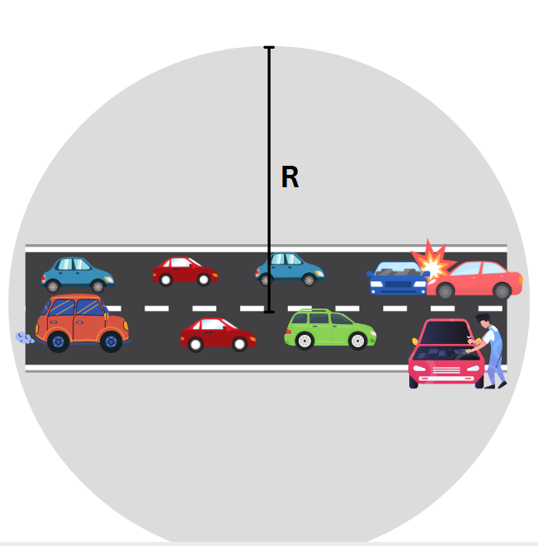
Scenario 2
To tackle this we will set a given circular perimter having radius R
The Radius R permits us to know the users in our app who are in the perimeter
After this is done we created an Algorithm to tackle this :

Slide 14
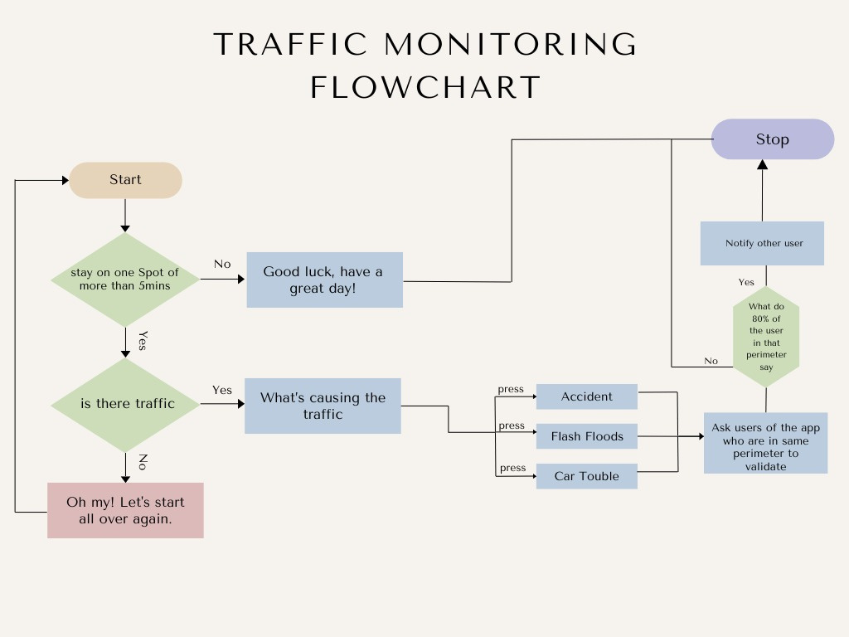

Scenario 2

Slide 15
Scenario 2
A user Approaching the set perimeter can be redirected to another route depending on this preference.
This analysis of the various scenarios needs to make sure brings in the need for the following requirements
Security
Performance
1
2
Reliability
Scalability
3
4

Slide 16
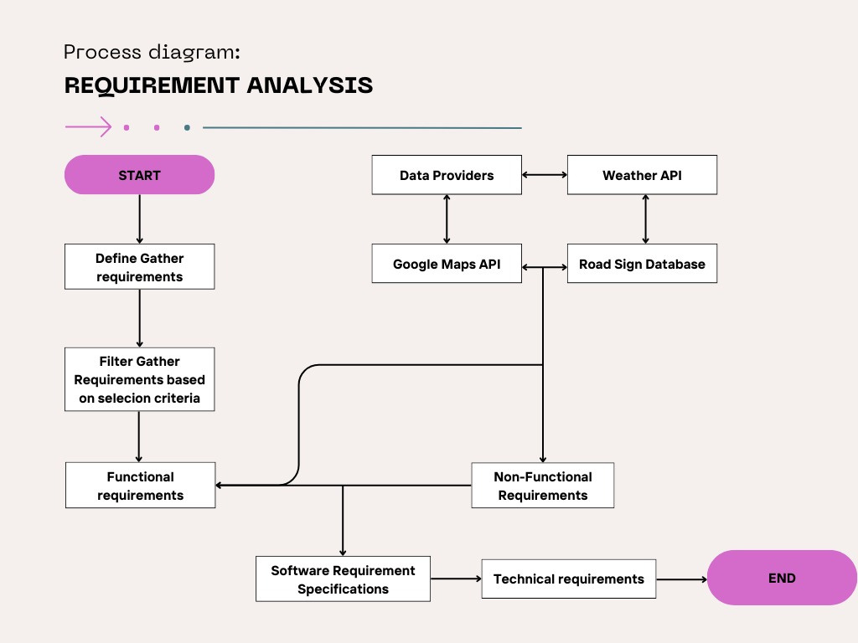
SRS Document

Slide 17
Filtered Non-Functional Requirements
5
i
Performance
v
Scalability
ii
Reliability
vi
Availability
iii
Security
vii
Maintainability
iv
Usability
viii
Compatibility

Slide 18
6
Conceptual Design

Slide 19

Technical Requirement
7
i
Front-End
React Native
Cross Platform
API Integration
Access to Native functionalities
User Centric
ii
Back-End
Nodejs with Expressjs and Firebase
Easy authentication
Clean Architechture
iii
Database
MongoDB and Fire-store
Flexibility
Scalability
Real-time database
Cloud fire-store

Slide 20


8
Conclusion
Requirement Analysis is not a shopping list but detective work. It requires proper and analysis of the system
Smart move

